Slide 1

ParkCar
Group B1-2
1805062
1805088
1805089
1805090
1805106
1805111

Slide 2
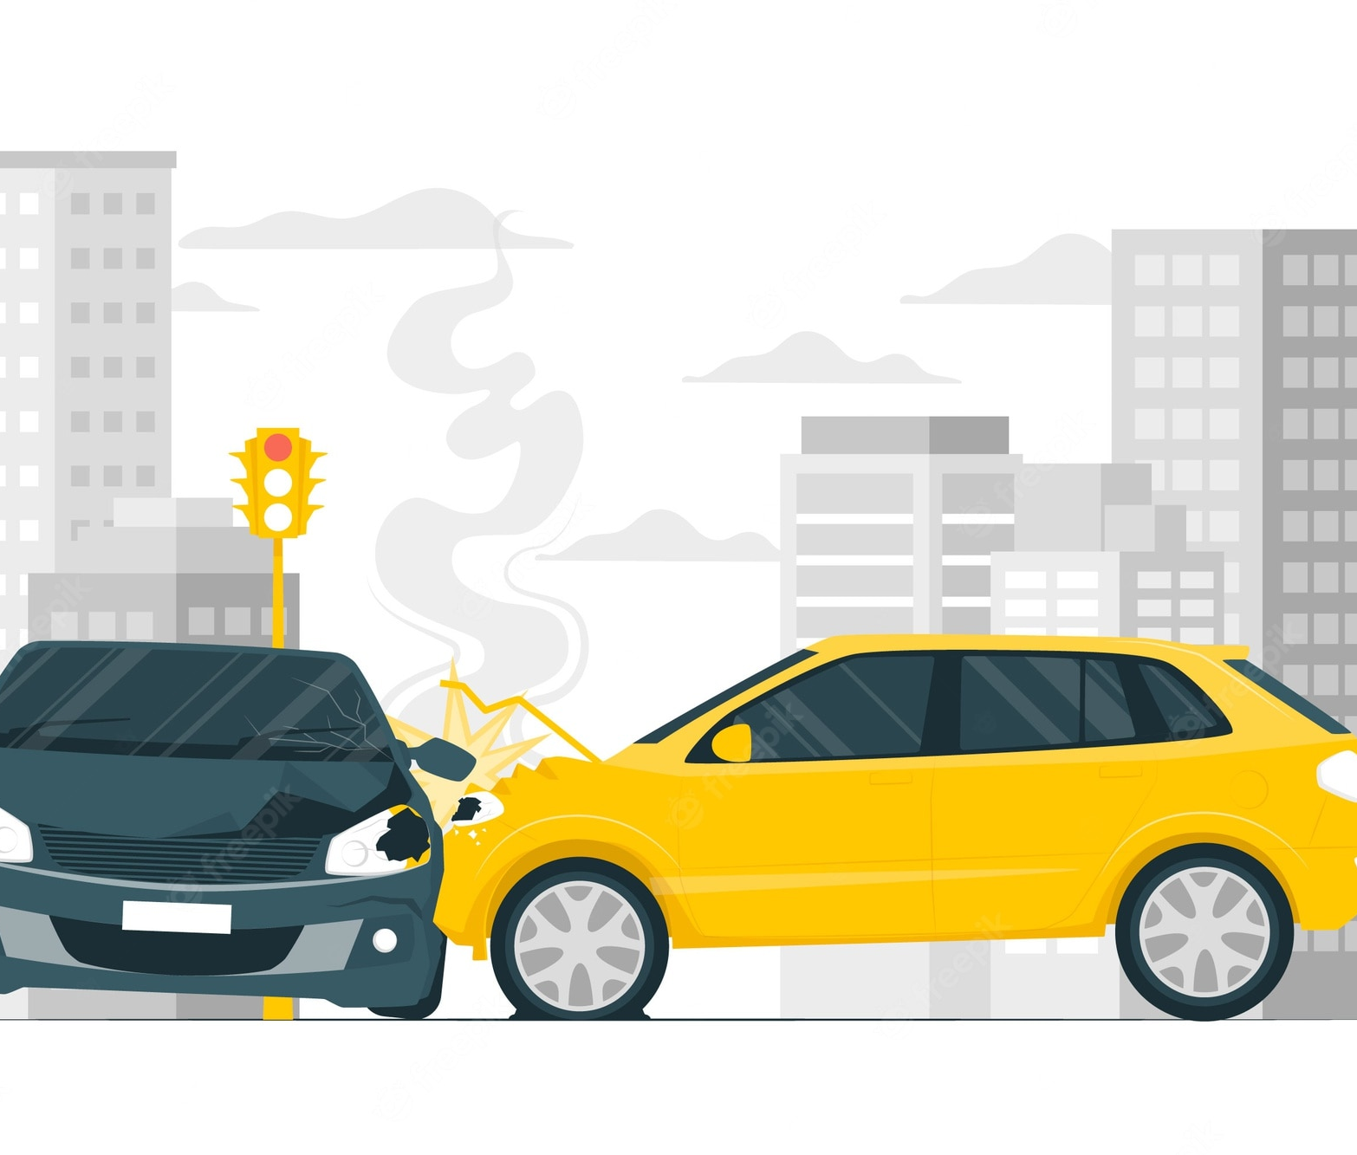

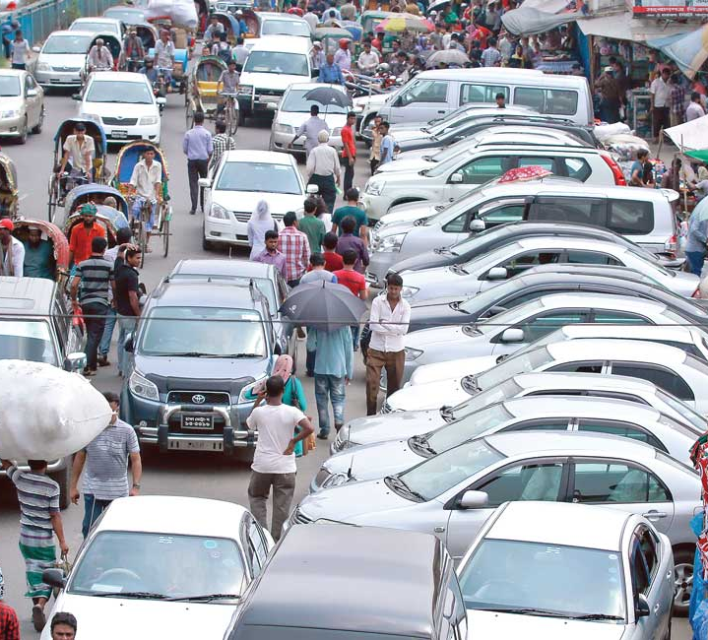
Motivation
Reducing Traffic Jam
Ensuring Car Safety
Preventing Accident
Utilization of Space
Avoiding Car theft
Self-employment

Slide 3

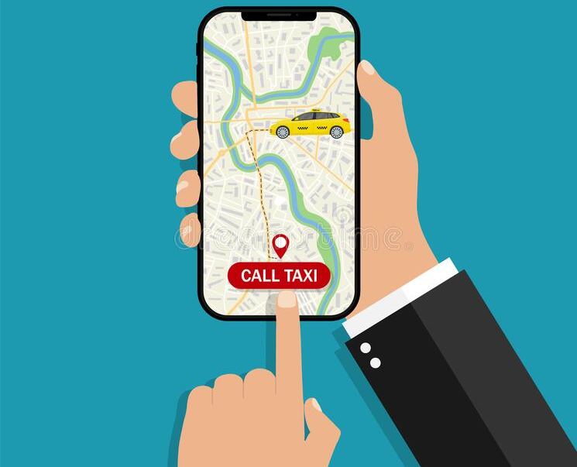
Modules
Parking Spot Registration
Car Registration
Search & Request
Payment/Rent
User Review
Complaint System
BOOK SPACE

Slide 4


Parking Spot Registration
Necessary information
Address
Security Measures
Verification
In person

Slide 5
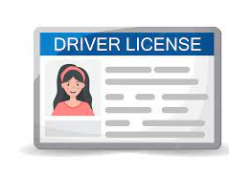

Car & Driver Registration
Necessary Information (car)
Registration Copy
Necessary Information (driver)
Name
License copy
Verification (BRTA)

Slide 6

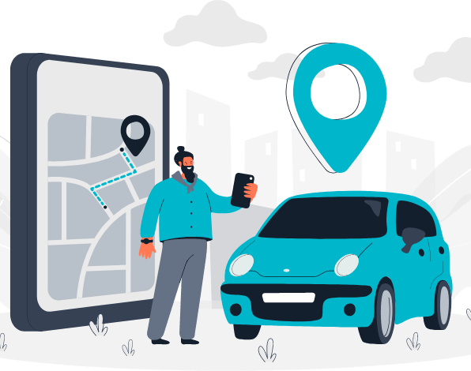
Search & Request
Search parameters
Location
Time
Availability
Filter/Sort
Distance
Fare
Security

Slide 7
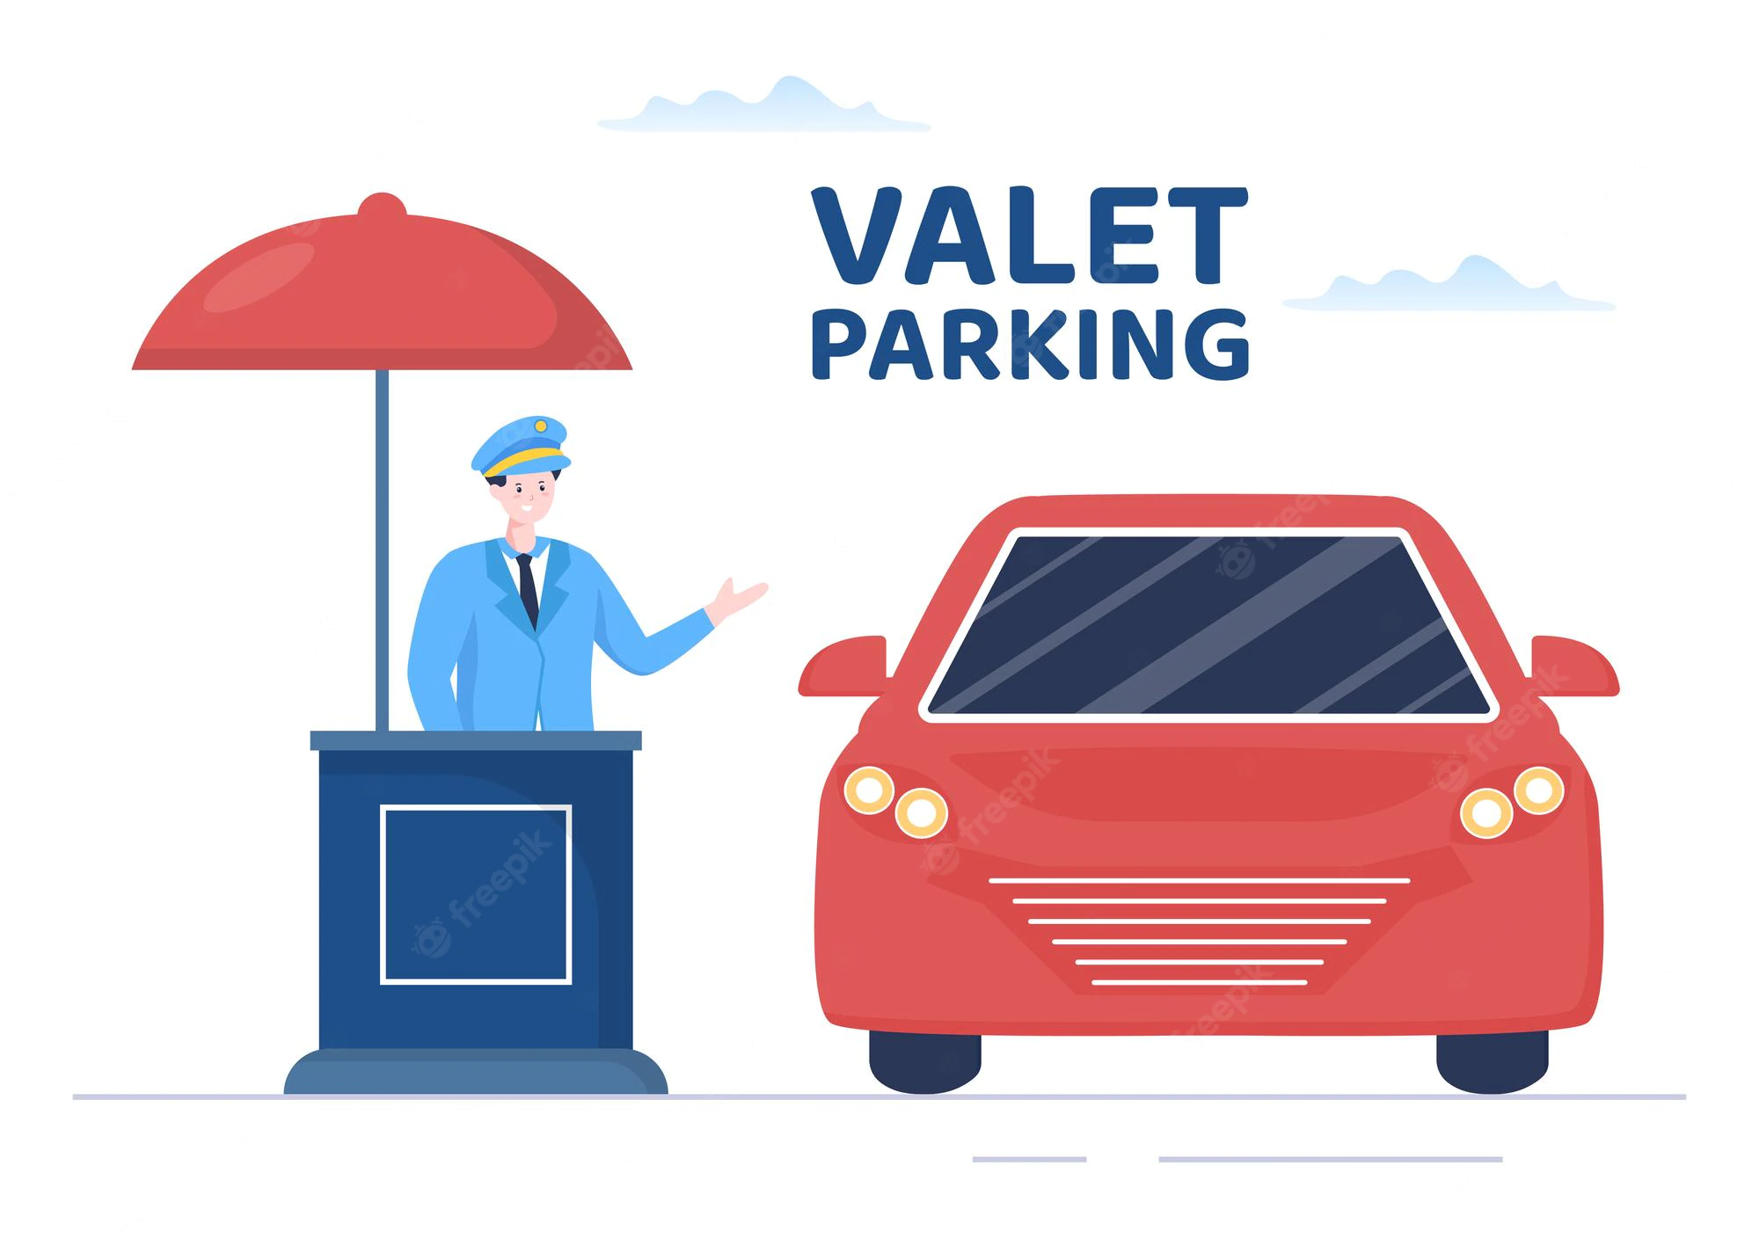

Payment
Rent
Baseline determined using time, location & security measures
Owner will decide exact value
Payment
Prepaid
Digital Financial Service
Receipt generation on Payment

Slide 8

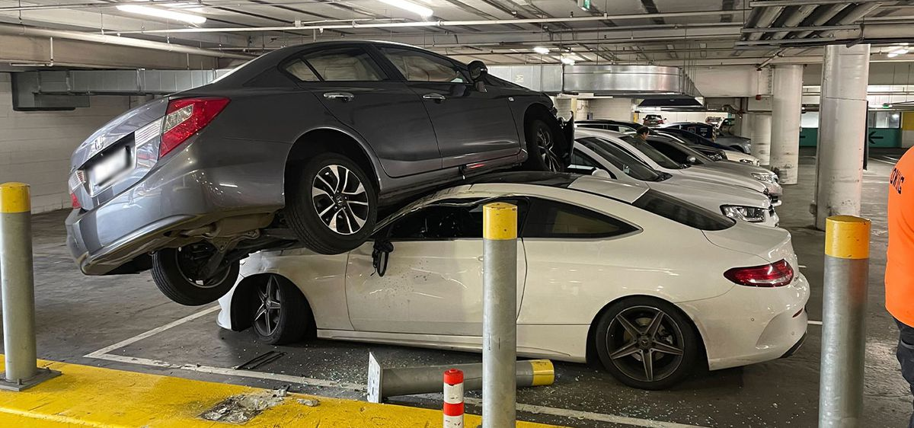
User Review & Complaint System
User Review
From both parties
Complaint System
Material Damages
Lack of Security

Slide 9

Opportunities
Huge untapped potential
Influx of users due to Digital Revolution
Currently no strong competition

Slide 10
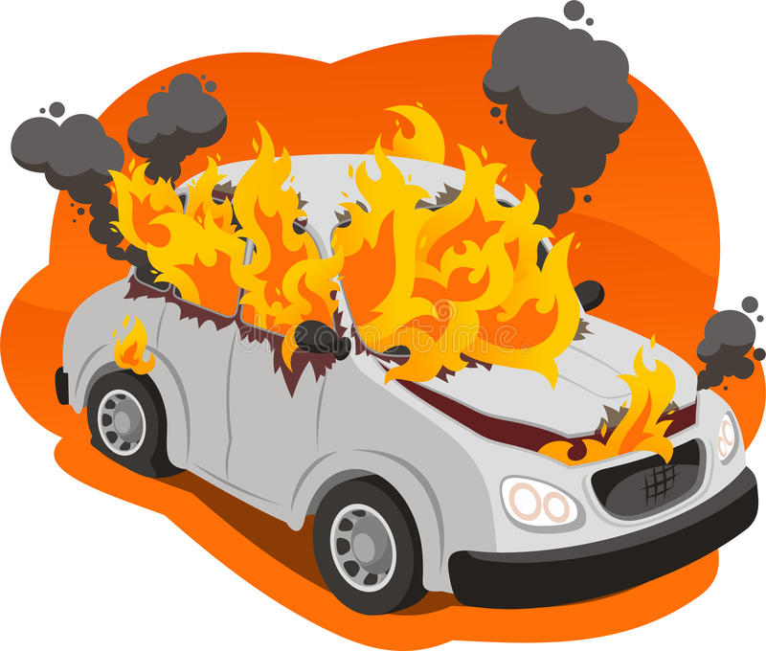


Threats
Security threat
Established companies can easily dominate the market

